Slide 1
Microsoft AI & ML Platform Update Last Updated February 2019
Bart Czernicki
@bartczernicki
baczerni@microsoft.com

Slide 2
Microsoft AI Platform
AI SERVICES
AI TOOLS
CONVERSATIONAL AI
TRAINED SERVICES
CUSTOM SERVICES
CODING & MANAGEMENT TOOLS
Bot Framework
Cognitive Services
Azure Machine Learning
VS Tools for Machine Learning
Azure ML Studio
Azure ML Workbench
AI INFRASTRUCTURE
Others (Pycharm, Jupyter notebooks…)
AI ON DATA
AI COMPUTE
DEEP LEARNING FRAMEWORKS
Cosmos DB
SQL
DB
SQL
DW
Data Lake
Spark
DSVM
Batch AI
ACS
Edge
Cognitive Toolkit
TensorFlow
Caffe
CPU, GPU, FPGA
Others (Scikit-learn, MXNet, Keras, Gluon…)

Slide 3
Microsoft AI Platform – Empowering All Types of Personas
Empower Information Workers of varying Data Science & Analytics skillsets to contribute in building AI solutions
Application Developer
Data Subject Matter Expert
Skilled at application development and system engineering, but no formal Data & AI skillset
Microsoft AI includes Cognitive Services provide ready-to-consume APIs exposed as RESTful endpoints that can inject AI into any application without building models.
Skilled in the organizational data domain, but no formal Data & AI skillset. Typical role: data steward
Microsoft AI exposes Adaptive Learning frameworks that allow domain SMEs to bring their own data and build sophisticated machine learning models using web applications that abstract data science complexity
Platform Data Scientist
Professional Data Scientist
Skilled in Data & AI theory, but not familiar with cloud & infrastructure. Typical role: statistician or actuary
Microsoft AI includes various advanced analytics software exposed as PaaS and SaaS offerings that accelerate data scientist productivity by “managing” the analytical infrastructure intricacies
Comfortable working in statistical algorithms and AI infrastructure. Typical role: PhD Data Scientist
Maximize data science choices & flexibility: frameworks, languages, tools, server hardware & location can all be specifically tailored to meet the most demanding organizational AI needs

Slide 4
Microsoft AI Platform Products (Consume vs Build)
Microsoft ML & AI Products
Consume (Pre-built AI)
Build your own (Custom AI)
Cognitive Services
CoreML & Vision CNTK, TensorFlow
(pre-trained)
Custom
Cognitive Services
(Custom Vision, Custom Speech)
Azure Machine Learning Studio
Azure Notebooks
Azure DSVM
Azure Databricks
Machine Learning Server
SQL Server 2016/2017
VS Tools for AI, R, Python
Machine Learning .NET
Azure ML Services
Azure ML Python SDK
Easier / Less control / Application Developers
Harder / Full control / Data Scientists
Novice ML & AI knowledge | Intermediate ML & AI knowledge | Advanced ML & AI knowledge
Consume pre-built AI models | Build your own AI models with PaaS tools | Build your own AI models however your like
Compute is provided for Azure services | Compute is provided for Azure services (via PaaS) | Provide your own compute AI infrastructure (cloud, on-premises) or leverage Azure PaaS compute services
No coding required for building models. Code only for consuming models | UI web driven & code-first development environments | Code-first development environments for building & consuming AI/ML models
Azure PaaS & pre-build model customer support | Azure PaaS customer support. Custom models are responsibility of developer. | Azure PaaS, IaaS & software (i.e. SQL Server) customer support. Custom models are responsibility of developer
Azure cloud services utilized | Azure cloud services utilized | Azure cloud services utilized or 100% on-premises options

Slide 5






Microsoft Cognitive Services Give your apps a human side
Vision
From faces to feelings, allow your apps to understand images and video
Speech
Hear and speak to your users by filtering noise, identifying speakers, and understanding intent
Language
Process text and learn how to recognize what users want
Knowledge
Map complex information and data in order to solve specific tasks
Search
Access billions of web pages, images, videos, and news with the power of Bing
Labs
An early look at emerging Cognitive Services technologies: discover, try, and give feedback on new technologies before general availability

Slide 6
Cognitive Services – Live Demos https://azure.microsoft.com/en-us/services/cognitive-services/ Live demos you can try yourself

Slide 7
Uber – Identity Facial Recognition
Cognitive Services Software Augmentation
https://blogs.microsoft.com/firehose/2016/09/26/powered-by-microsoft-cognitive-services-uber-begins-using-driver-selfies-to-enhance-security/

Slide 8
Docker Containers – Cognitive Services https://azure.microsoft.com/en-us/blog/running-cognitive-service-containers/ Demo of using Cognitive Service API functionality as local Docker Containers
+

Slide 9
Cognitive Services – Custom Vision Demo https://github.com/bartczernicki/ImageClassificationStateLicenses Build an Image Classifier in 5 minutes with no deep learning knowledge required!

Slide 10
Cognitive Services – Cognitive Search https://docs.microsoft.com/en-us/azure/search/cognitive-search-concept-intro Putting individual Cognitive Services into a compete solution

Slide 11
JFK Files – Web Site
Cognitive Services, Azure Search & .NET
Demo Site: https://jfk-demo.azurewebsites.net/
Source Code: https://github.com/Microsoft/AzureSearch_JFK_Files

Slide 12
Wolters Kluwer – SEC Documents Web Site
Cognitive Services, Azure Search & .NET
http://wolterskluwereap.azurewebsites.net/

Slide 13



Simple Data Enrichment using Azure Functions
Can run on Azure cloud & on-premises using Azure Stack
Can easily add new functions in parallel workflow
Custom models, customer customizations
Serverless – scales as needed, asynchronous or synchronous
Node.js, C#, Python – Python for directly training/inference of Python models
Cosmos DB
Event Trigger
New Documents
(PDF, Office, HTML)
Document Manipulation Function
Uses document management library
Splits the various document types into pages
Pages are rendered into individual PNG files
PNG pages persisted in BLOB Storage container
Vision Function
Takes a set of images and uses Cog Services OCR endpoint to get text stream
Images need white background
Images need to be less than 4200x4200 resolution keeping scale
Image needs to be less than 4meg
JSON Output map is persisted in BLOB Storage container
Core Text Analytics Function
Takes text character stream and uses Cog Services Text Analytics to build core text features
Extracts Key Phrases
Extracts NEL (needs to be added)
Call Bing Search for NER for each NEL entity
Extract Entity Taxonomy
Calculates basic text metrics: text size etc.
ML/AI Enrichment Functions
Call operationalized models for:
doc classification
sub-classification
Financial table identification
Models can be REST APIs, Container endpoints or in-memory models (i.e. ONNX)
Azure Functions v2 supports Python, so Python models can be called directly as well
Data Persistence Function
Write enriched data into Cosmos DB
Language Understanding Function
Call Language Understanding models
Extract custom NER entities from
Language Understanding
Azure Functions can be chained using either intermediate queues or durable function pattern.
Durable functions: https://docs.microsoft.com/en-us/azure/azure-functions/durable-functions-overview
Pipe Queue Pattern: https://docs.microsoft.com/en-us/azure/architecture/patterns/pipes-and-filters

Slide 14
Power BI – Desktop & Service
Mix Analytics with Advanced Analytics
Enhance BI with ML & AI directly for report author, data analyst personas
Integrate R & Python - model inference, feature engineering, statistical modeling and data visualizations
Author with Power BI Desktop & Publish to the Power BI Service
Includes Automated ML (public preview March 2019)
https://powerbi.microsoft.com/en-us/blog/power-bi-announces-new-ai-capabilities/

Slide 15
Azure Machine Learning Studio
Rapid Prototyping, Hackfests, Platform Data Scientists
Serverless Architecture
End-to-End Machine Learning in a single holistic web application facilitates rapid prototyping
Rapid operationalization with web services
Extensibility with open-source R and Python packages or scripts
Added 3.4.4 MRO support recently
Big Updates for 2019
http://studio.azureml.net

Slide 16
Azure Notebooks Service
Jupyter Notebook Service On Azure
Hosted Jupyter Notebooks Service
Free Compute to Get started
Bring Custom Azure Compute – Data Science Virtual Machine
Python, R, F# Language Support
Connect() 2018 Announcements:
https://github.com/Microsoft/AzureNotebooks/wiki/Azure-Notebooks-at-Microsoft-Connect()-2018
https://notebooks.azure.com

Slide 17
Azure Notebooks – Sports Statistics & Analytics Book https://notebooks.azure.com/bartczernickimsft/projects/SportsAnalyticsAndStatistics Example of an interactive book (content & code) hosted in a Jupyter web application in Azure Notebooks

Slide 18


Azure Databricks
Apache Spark-based Service for Big Data & Artificial Intelligence
Leverages an optimized Apache Spark Engine
Collaborative Environment for various analytics personas (Data Scientists, Data Engineers)
Write distributed machine learning programs across clusters
Python, R, Scala, PySpark, SQL Support
Build Real-Time, Batch, Deep Learning Support
Databricks Licenses priced into usage costs
https://azure.microsoft.com/en-us/services/databricks/

Slide 19
Machine Learning .NET
Cross-Platform & Open-Source Framework for Machine Learning Development for .NET Developers
Part of upcoming .NET Core 3.0
Visual Studio Windows & Mac
Deploy to .NET, .NET Core, Docker, IoT Edge
Rapid Release Cadence with modern ML & AI Algorithms
https://github.com/dotnet/machinelearning

Slide 20
ML.NET – Baseball Hall Of Fame Prediction https://github.com/bartczernicki/baseballhof-macos Build a binary classifier, evaluate performance metrics and export as ONNX format all in .NET Core

Slide 21
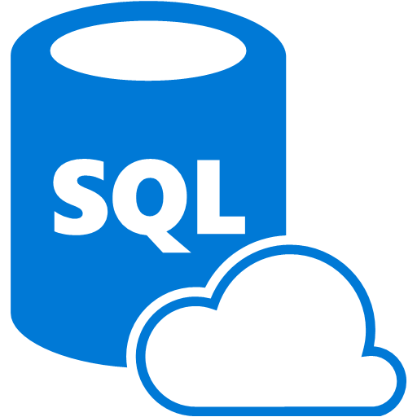
Azure SQL Database & SQL Server – Machine Learning Services
Bring Machine Learning into your database
Train Models and Perform Machine Learning Inference Directly inside SQL Server
Reduce data movement & take advantage of SQL Server indexes, parallelization, memory management
Machine Learning Services completes the trifecta of model deployment: APIs (Docker), Memory (next to business logic) & Databases
https://docs.microsoft.com/en-us/azure/sql-database/sql-database-connect-query-r

Slide 22
Azure SQL Database – Model Ensemble Demo Build and evaluate a simple ensemble model inside SQL Server Database

Slide 23
Azure Machine Learning service
Bring AI to Everyone with a end-to-end scalable trusted platform
Built with your needs in mind
Automated machine learning
Managed compute
DevOps for machine learning
Simple deployment
Tool agnostic Python SDK
Support for open source frameworks
https://azure.microsoft.com/en-us/services/machine-learning-service/

Slide 24





Azure Machine Learning service – Full Platform
Consume AI – Cognitive Services
Sophisticated pretrained models
To simplify solution development
…
Vision
Speech
Language
Search
Build AI – Azure Machine Learning Services
Popular frameworks
To build advanced deep learning solutions
Pytorch
TensorFlow
Keras
Onnx
Productive services
To empower data science and development teams
Azure Databricks
Azure Machine Learning
Machine Learning VMs
Powerful infrastructure
To accelerate deep learning
CPU
GPU
FPGA
Flexible deployment
To deploy and manage models on intelligent cloud and edge
On-premises
Cloud
Edge

Slide 25






Popular frameworks Build advanced deep learning solutions
Use your favorite deep learning frameworks
without getting locked into one framework
TensorFlow
PyTorch
Scikit-Learn
ONNX
Community project created by Facebook and Microsoft
Use the best tool for the job. Train in one framework and transfer to another for inference
MXNet
Chainer
Keras
Notes:
Our approach to ML frameworks is simple.
We give customers the flexibility to choose their deep learning framework, without getting locked one framework.
To help with this we’ve created a community project in partnership with Facebook that allows customers to train in one framework and use another one for inference
Now, let me move to the ML services on Azure

Slide 26
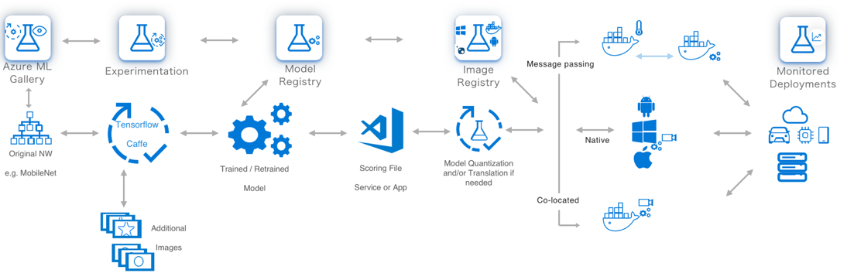
The components of a ML application

Slide 27
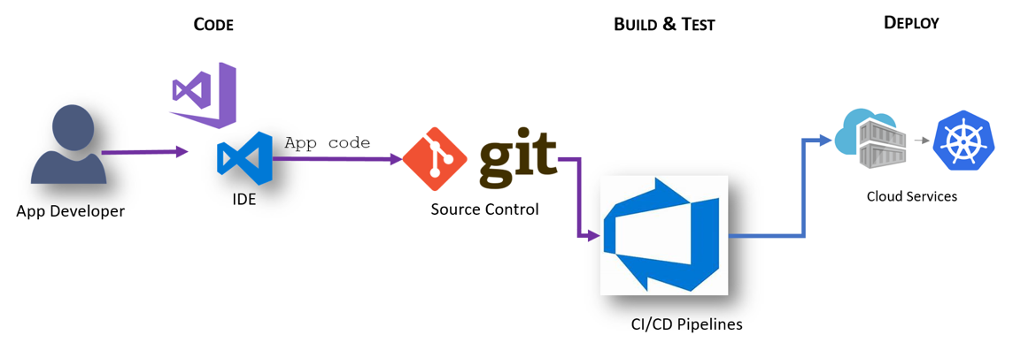
Workflow: App Developer
Basic Workflow: App Developer
Workflow: App Developer
Notes:
Test Scenario in Build is unit test
Integration is E2E tests, testing complete application.

Slide 28
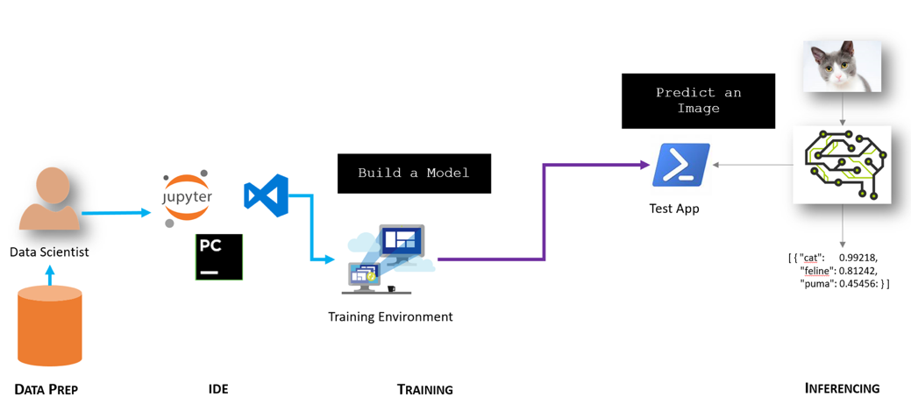
Workflow: Data Scientist
Basic Workflow: Data Scientist
Workflow: App Developer
Notes:
Data scientists spend a lot of time shaping data, figuring out which features are most relevant to their scenario, and figuring out which algorithm is best to solve their problem.
Test Scenario in Build is unit test
Integration is E2E tests, testing complete application.
Challenges of ML in DevOps
Testing of Stastical results – pick one (accuracy, f1 or other) and stick to it. Have goal to improve that metric. Second aspect is testing the dataset itself, have correct split between training and testing.
In ML change in results can happen without change in code (eg. Retraining) and it should produce newer releases. Github can’t store datasets, so it has to be stored in a storage location.
Time to train the classifier – Re-Training can take hours or days, can’t really train on each build, but have to do it nightly, weekly or biweekly.
Architectural approaches –
Include full processing into your CI/CD cycle.
Carve out ML into a separate service, as different services can have different stack.

Slide 29














Microsoft AI – DevOps (App Developer & Data Scientists)
Artificial Intelligence Development Pipeline (CI/CD)
Update Application
Deploy Application
Cloud Services
App Developer
IDE
DevOps Pipeline
Validate & Flight Model + App
Consume Model
Deploy Model
Apps
Customize Model
Model Store
Predict
Edge Devices
Publish Model
[ { "cat": 0.99218,
"feline": 0.81242 }]
Data Scientist
Retrain Model
Model Telemetry
Collect Feedback
IDE

Slide 30












Data Science Lifecycle
The Major Buckets & What Tools People Use
Simplified (no CI/CD concepts present)
Prepare Data
Build & Train
Run
LOB
CRM
Azure Databricks
Azure Databricks
Azure ML / AKS
Graph
Mobile Apps
Azure ML
Image
Azure IoT Edge
Azure Data Lake
Social
Batch AI
IoT
Apps + insights
IoT
Ingest, Wrangle Data and Prepare Datasets for Training
Build models with many toolkits (normally Python based)
Deploy, Version, Manage & Monitor AI Models on Cloud + Apps + Edge
Cloud
Notes:
We are expanding and improving Azure Machine Learning service, by expanding to Azure Machine Learning Experimentation and Model Management services which offer a cloud, on-premises, and edge solution for data scientists and developers to bring AI everywhere, to everyone. ​
Azure Machine Learning Experimentation Service allows developers and data scientists to increase their rate of experimentation. Rapidly prototype on their desktops, then easily scale up on virtual machines or scale out using Spark clusters. These services allow developers and data scientists to proactively manage model performance, identify the best model, and promote the best model with data. Collaborate and share solutions using powerful, industry standard GIT repositories. ​
Azure Machine Learning Model Management allows developers and data scientists to deploy and manage their models everywhere. Use Docker containers to deploy models into production faster in the cloud, on-premises, or edge. Promote your best performing models into production and re-train them when their performance degrades. Deploy as real-time or high throughput batch services. ​
Leverage the best open source frameworks such as TensorFlow, Cognitive Toolkit, Spark ML, scikit-learn, and more. ​

Slide 31
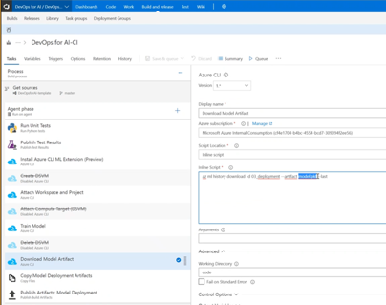
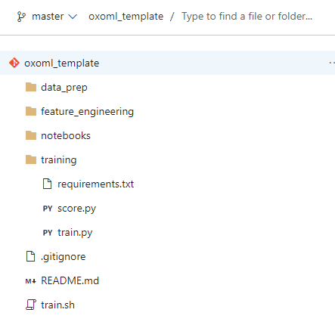
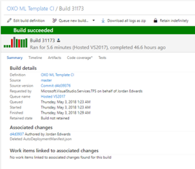
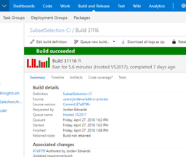
Model Source Control
Processes and procedures to make models reproducible (from source control to data retention policies)
Make it easy to work on multiple models (consistent process)
Trigger training and deployment on commit
Or whatever user specifies as a requirement

Slide 32
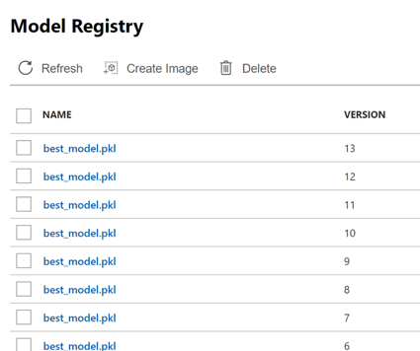
Model Versioning & Storage
Train your model with AML
Import your model from the AI Gallery
Bring your own model
ONNX – goal is to be interoperable format for models (early stages)
Provide a consistent way to discover, store, track & share models
Provide a consistent model metadata format
Provide traceability on where a model came from (which data, which experiment, where’s the code / notebook)
Track where model is running
Control who has access to what models
Private / compliant data

Slide 33
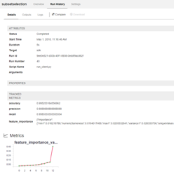
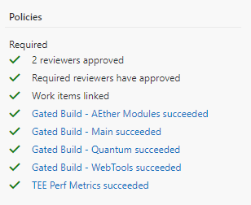
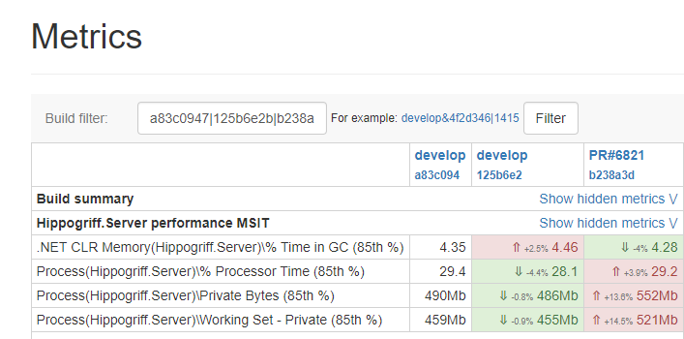
Model Governance
Profile and validate
Model in isolation
Model when embedded / optimized for application
Gate promotion of the model on validation
Assess
Functional behavior
Performance characteristics
Validate offline and online
A/B lets us test with live data

Slide 34
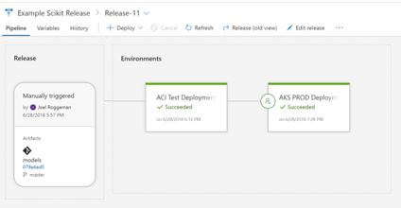
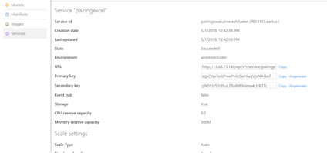
Model Deployment
Provide an efficient process to get a model build into an application or service.
Simplify the process to interact with the model (through code-generation, API specifications / interfaces or other methods)
Support a variety of inferencing targets
Cloud Services
Mobile / Embedded Applications
Edge Devices
Convert / quantize / optimize models for target platform
Manage secrets / service endpoints to remove friction from configuring the release process.
Control the rollout of your models (with A/B) (compliant + safe)
GOAL: Let customers focus on ML, not devops

